Slide 1


Embracing Sustainability
Developing Green Software Architectures with .NET 8

Slide 2


Chris Woodruff
Architect at Real Time Technologies Inc.
https://rt2.com
Podcast – Breakpoint Show
https://www.breakpoint.show/

Slide 3
Environmental impact
Cost savings
Performance

Slide 4


Slide 5

01
Overview of Sustainable Software Engineering

Slide 6
Six Ideas
Carbon Efficiency
Energy Efficiency
Carbon Awareness
Build applications that are energy efficient
Build applications that are energy-efficient across the global network
Consume electricity with the lowest carbon intensity
Hardware Efficiency
Networking
Optimization Over Time
Build applications that are hardware efficient
Reduce the data transfer footprint
Continuously improve the energy efficiency and carbon footprint of applications

Slide 7
02
Optimization of Applications

Slide 8
Three ideas
Profile Before Optimizing
Improve Algorithm Efficiency
Optimize Data Structures
Before making changes, use profiling tools to identify the most energy-intensive parts of the code. Focus your optimization efforts where they can have the most significant impact on performance and energy efficiency
Opt for more efficient algorithms that can perform the same tasks with fewer computational resources. For example, switching from a brute force approach to a more efficient algorithm can dramatically reduce execution time and energy consumption.
Use the most appropriate data structures for your tasks. Efficient data structures can reduce memory usage and speed up data access, thereby saving energy.

Slide 9
Three More Ideas
Minimize I/O Operations
Reduce Memory Usage
Leverage Multithreading and Asynchronous Programming
Input/output operations, especially disk and network operations, can be energy-intensive. Cache data when possible, batch I/O operations, and minimize unnecessary data transfers to reduce energy consumption.
Efficient memory use can reduce the amount of energy required for data processing and can also minimize the need for garbage collection, which can be resource-intensive.
Proper use of multithreading and asynchronous programming can help make better use of CPU resources, reducing idle times and improving overall efficiency. However, ensure that this is done wisely to avoid increased complexity and potential inefficiencies like excessive context switching.

Slide 10
Another Three ideas
Adopt Energy-Efficient Libraries and Frameworks
Implement Modular Design
Continuous Monitoring and Improvement
Use libraries, frameworks, and tools that are designed for efficiency. Some libraries are optimized for performance and low energy consumption, and choosing these can significantly reduce the environmental impact of your software.
Develop your software to be efficient even on lower-power hardware, which not only makes your software more accessible but also reduces its overall energy demand.
Regularly monitor the performance and energy consumption of your applications. Use insights gained from monitoring to make continuous improvements to code efficiency.

Slide 11
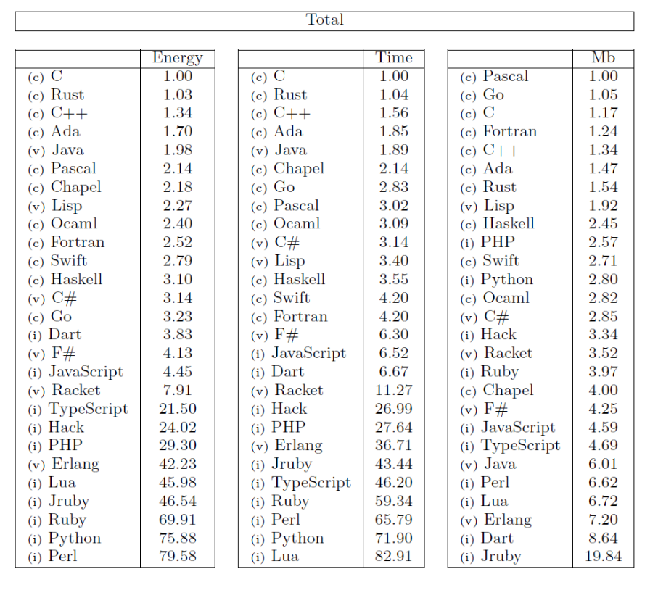
Languauge Efficiency

Slide 12
03
Optimization of Dеploymеnt

Slide 13
Three ideas
Energy-Efficient Hosting Options
Server Consolidation
Serverless Architectures
Choose hosting providers and data centers that use renewable energy sources or are committed to energy efficiency. Consider the location of data centers, as those in cooler climates can reduce cooling energy usage.
Reduce the number of physical servers by consolidating applications on fewer machines. Virtualization and containerization can help achieve this by allowing multiple applications to run on a single physical server more efficiently.
Utilize serverless computing models where possible. Serverless architectures can be more energy-efficient because they scale automatically and only use resources when needed, avoiding idle server time.

Slide 14
Three More Ideas
Scale According to Demand
Reduce Memory Usage
Efficient Deployment Pipelines
Implement auto-scaling for your applications so that resources are automatically adjusted based on actual demand. This can prevent over-provisioning and ensure that you're only using the energy necessary for the current workload.
Efficient memory use can reduce the amount of energy required for data processing and can also minimize the need for garbage collection, which can be resource-intensive.
Optimize your Continuous Integration/Continuous Deployment (CI/CD) pipelines for efficiency. Minimize the resources used by staging environments and ensure that testing and deployment processes are as streamlined as possible.

Slide 15
Another Three ideas
Optimize Asset Delivery
Lifecycle Management
Use Efficient Networking Practices
Use Content Delivery Networks (CDNs) to cache and deliver static assets closer to the end-users, reducing latency and energy consumption caused by long-distance data transfers.
Implement policies for the decommissioning of unused resources and services. Regularly review and turn off or scale down resources that are no longer needed.
Optimize network settings and protocols to reduce the energy used for data transmission, especially for distributed systems.

Slide 16
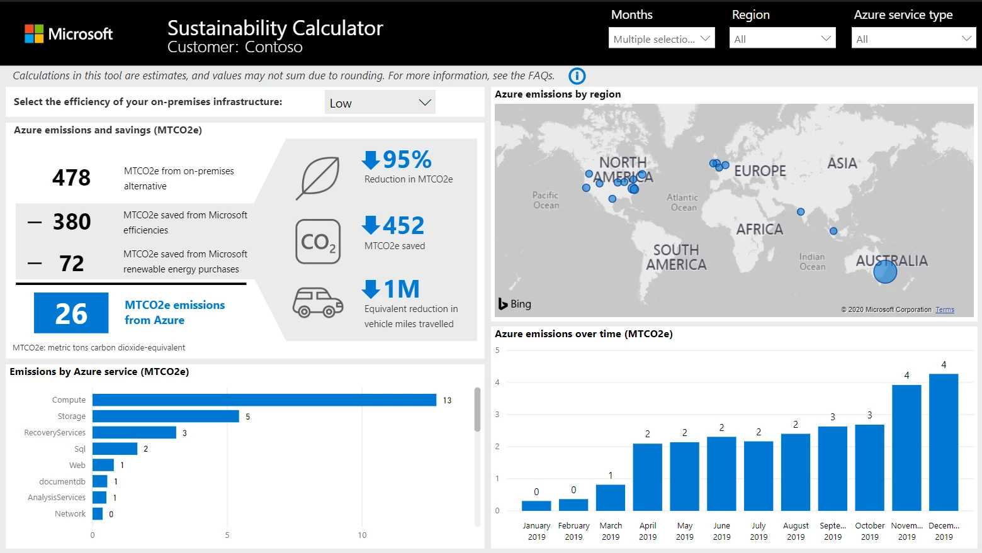

Slide 17
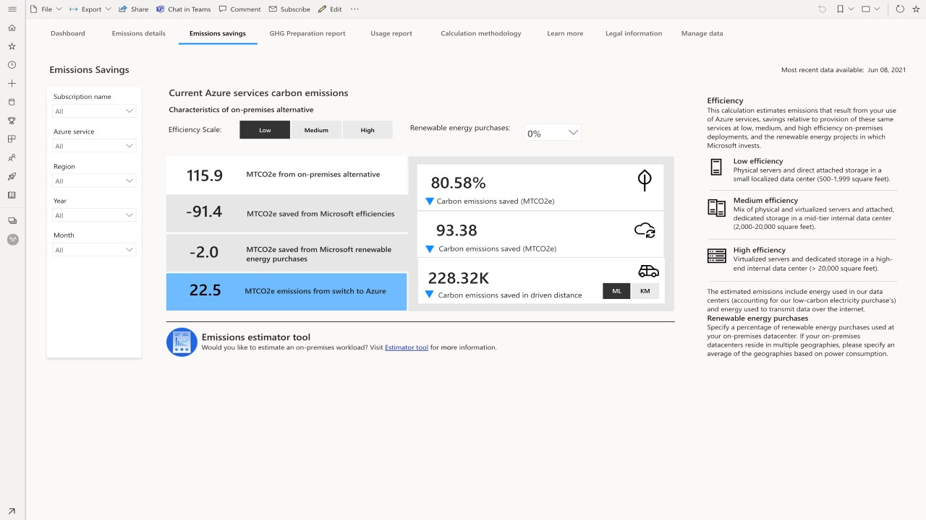

Slide 18
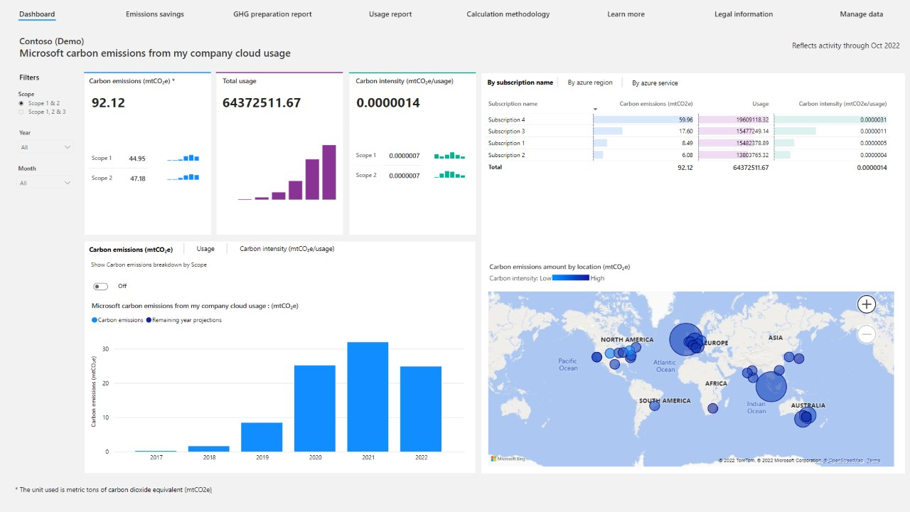

Slide 19
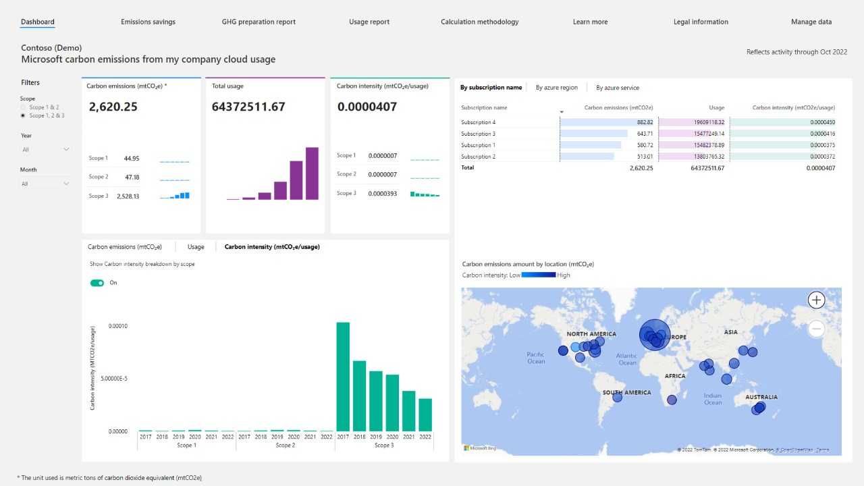

Slide 20
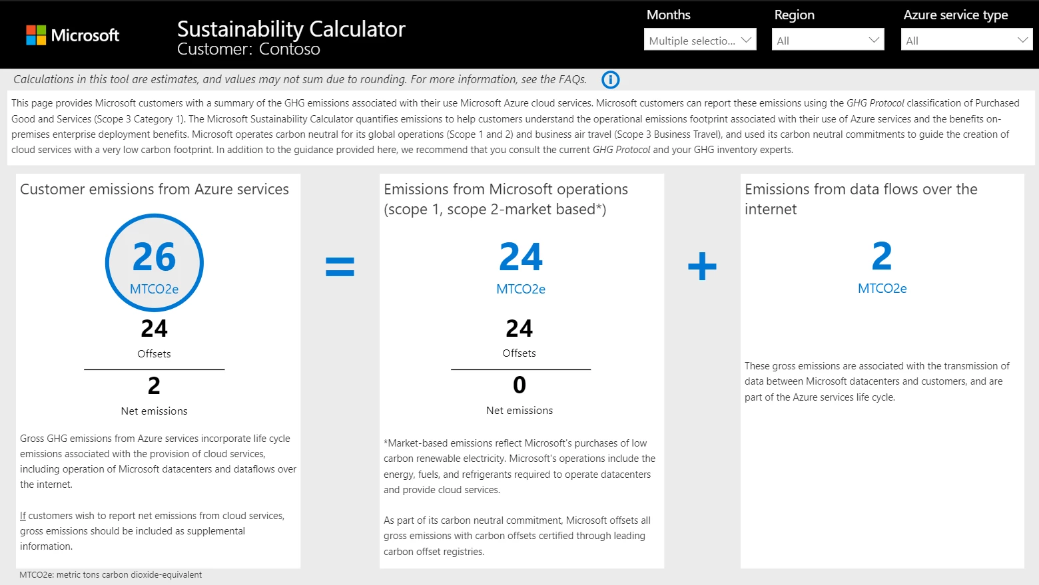

Slide 21
04
Application Architеcturе

Slide 22
Three ideas
Design for Efficiency
Modularity and Scalability
Use Green Frameworks and Libraries
Prioritize efficiency from the start. Design software architectures that minimize computational requirements, reduce memory usage, and optimize data processing. Efficient design reduces the energy consumption of both servers and end-user devices.
Build modular software that can scale up or down according to demand. This approach allows for more efficient use of resources, as components can be scaled independently based on their actual usage, reducing unnecessary energy consumption.
Choose frameworks, libraries, and tools that are known for their efficiency. Some frameworks are optimized to reduce energy consumption, which can have a significant impact on the sustainability of your software.

Slide 23
Three More Ideas
Leverage Cloud Computing
Implement Caching Strategically
Asynchronous and Event-driven Designs
Utilize cloud services that offer better energy efficiency compared to traditional on-premises solutions. Cloud providers often have access to renewable energy sources and more efficient hardware.
Use caching to save results of expensive operations. By storing and reusing previously computed information, you can reduce the need for repetitive data processing, thereby saving energy.
Employ asynchronous operations and event-driven architectures to reduce idle times and improve the efficiency of resource use. This can help ensure that computing resources are only used when necessary.

Slide 24
Another Three ideas
Design for Longevity
Optimize Data Storage and Transfer
Consider the End-user Devices
Create software that is durable and maintainable, reducing the need for frequent replacements or updates. This includes using well-established standards, writing clean and readable code, and ensuring good documentation.
Design data storage solutions that minimize redundancy and data transfer needs. Compress data when appropriate and use efficient data formats to reduce the energy required for data storage and transmission.
Design software that is efficient not just on servers but also on client devices. This includes optimizing for battery life in mobile apps and considering the energy impact of your software on users' devices.

Slide 25
05
.NET Ideas for Green Software

Slide 26
Profiling Tools
Visual Studio Profilers
JetBrains
dotTrace
dotMemory
PerfView
BenchmarkDotNet

Slide 27
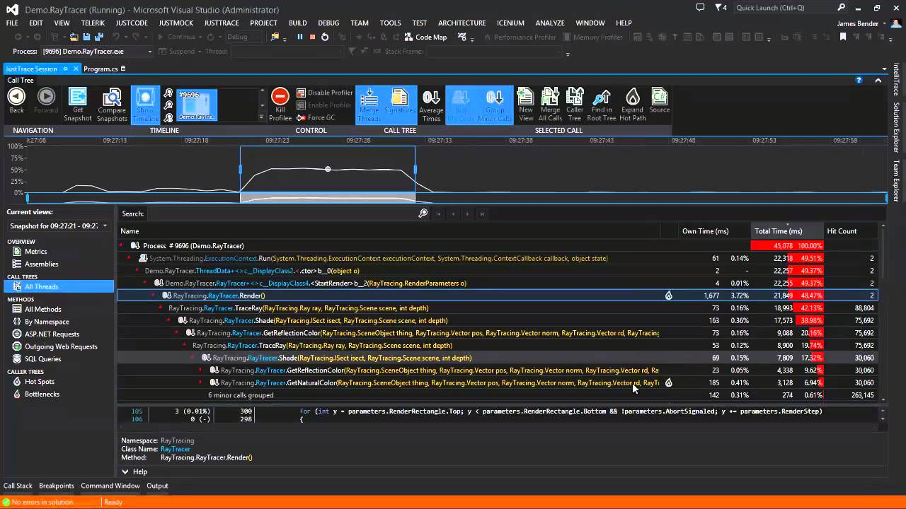
Visual Studio

Slide 28
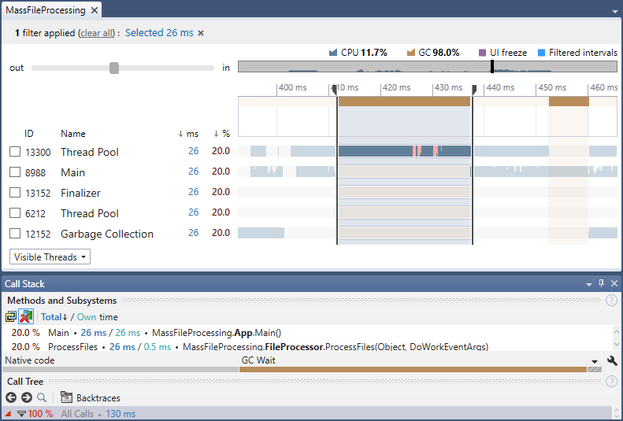
JetBrains dotTrace

Slide 29
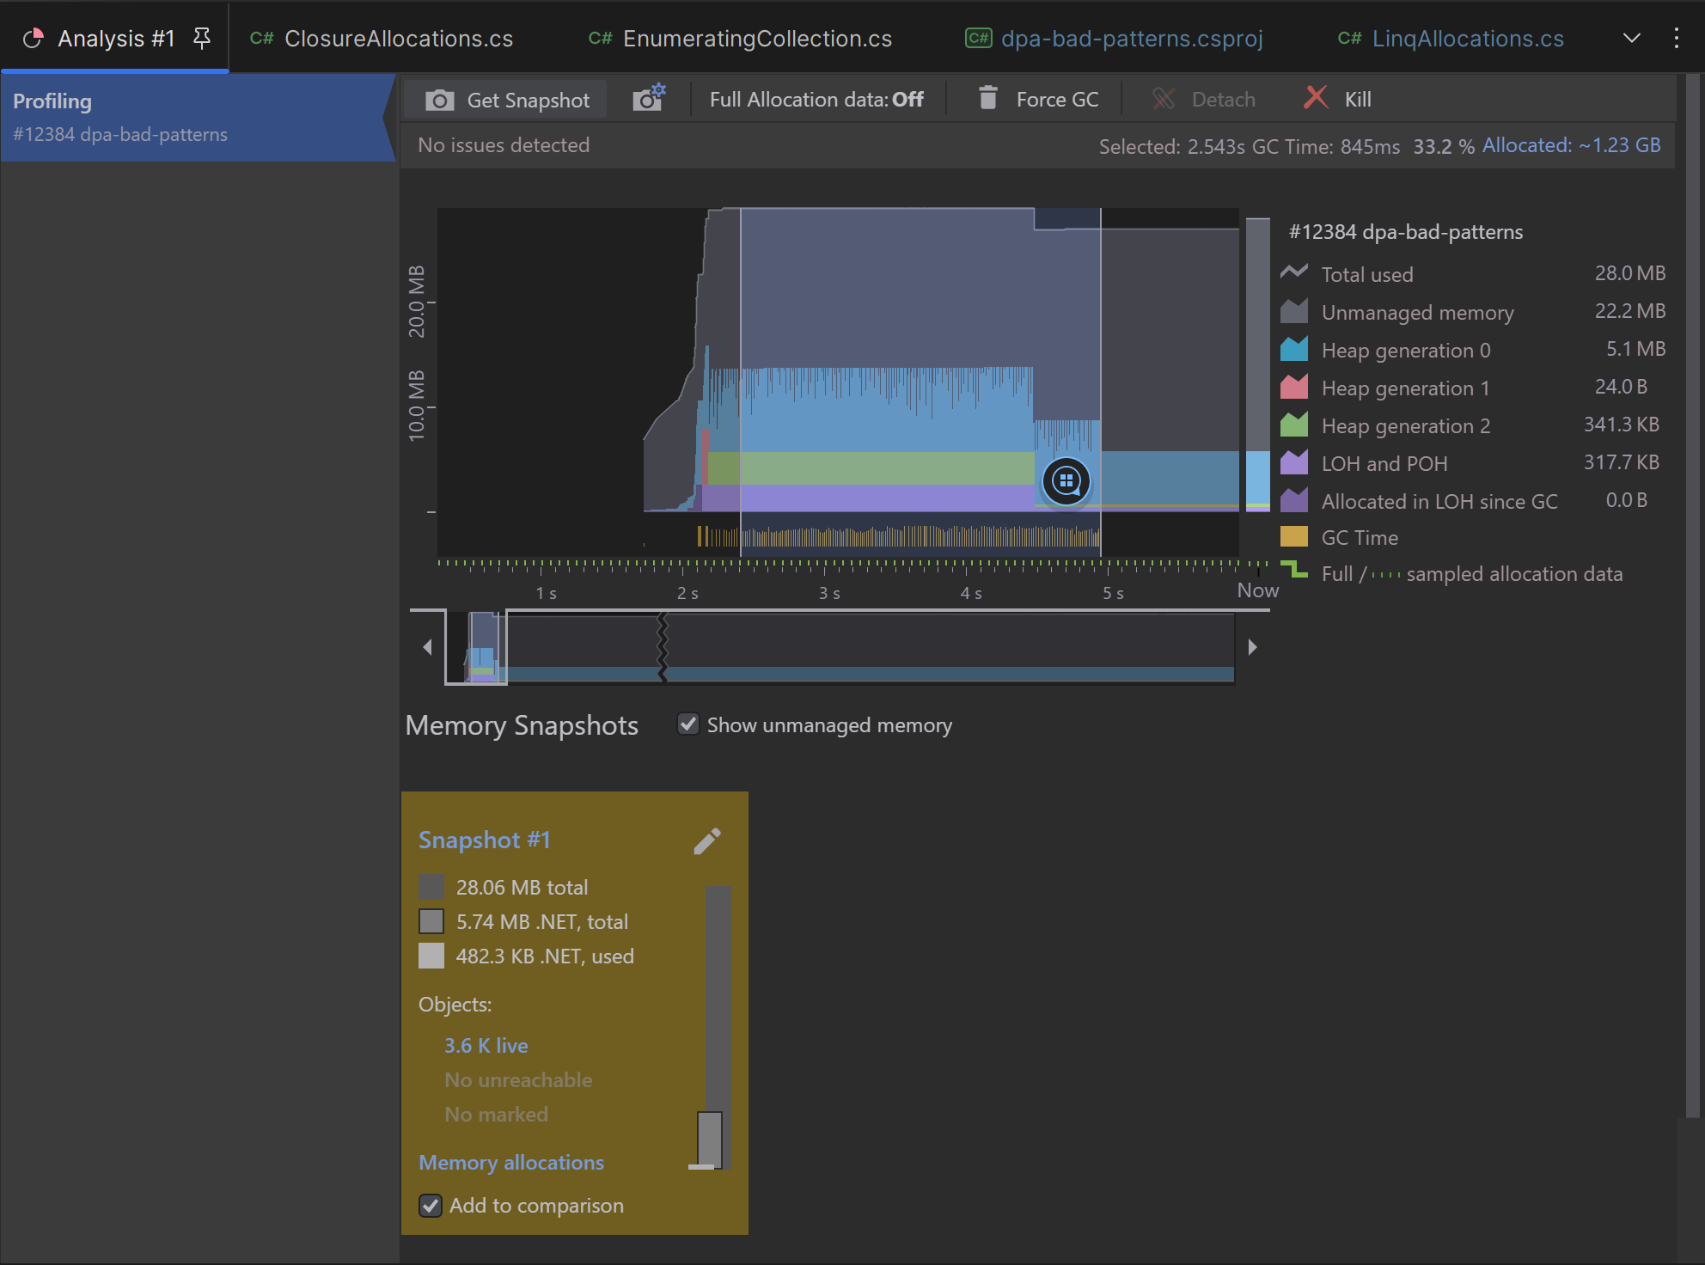
JetBrains dotMemory

Slide 30
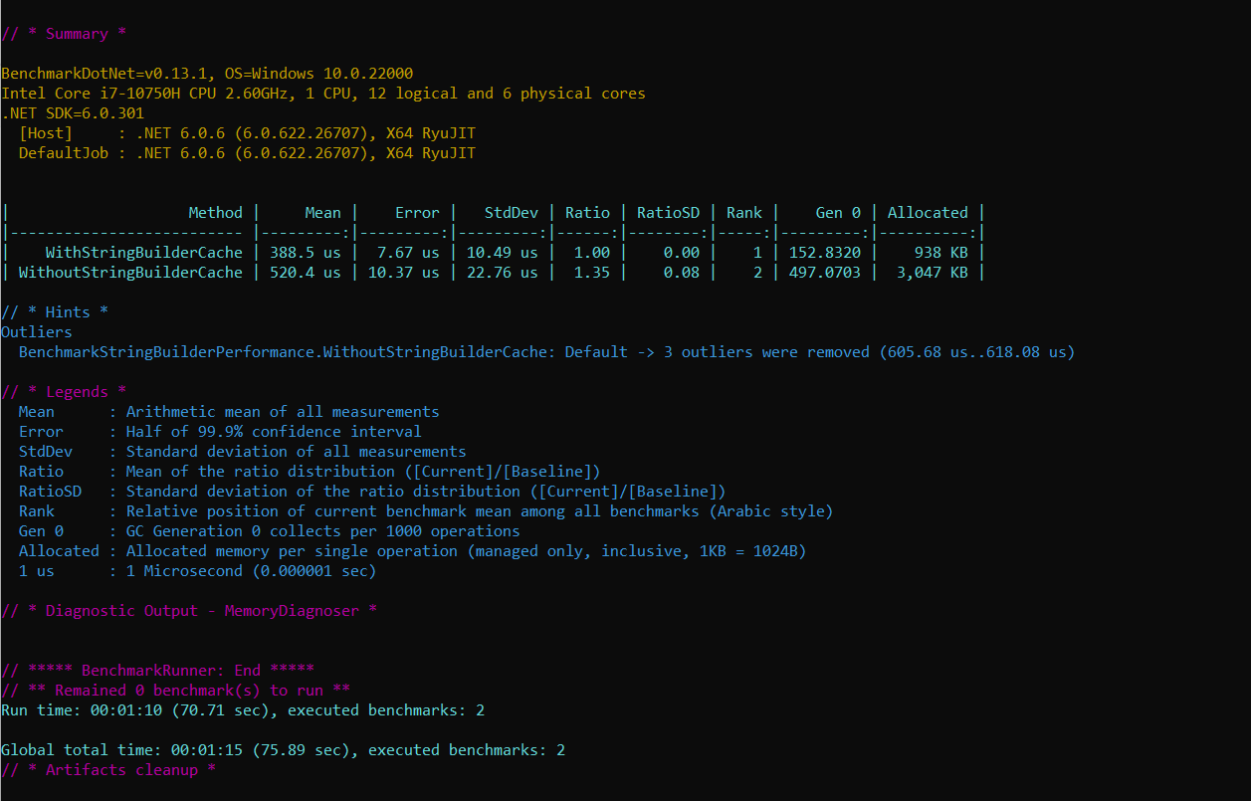
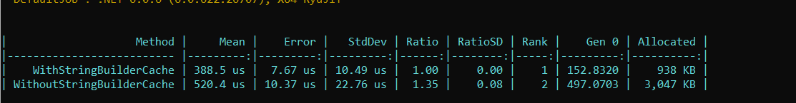
BenchmarkDotNet

Slide 31
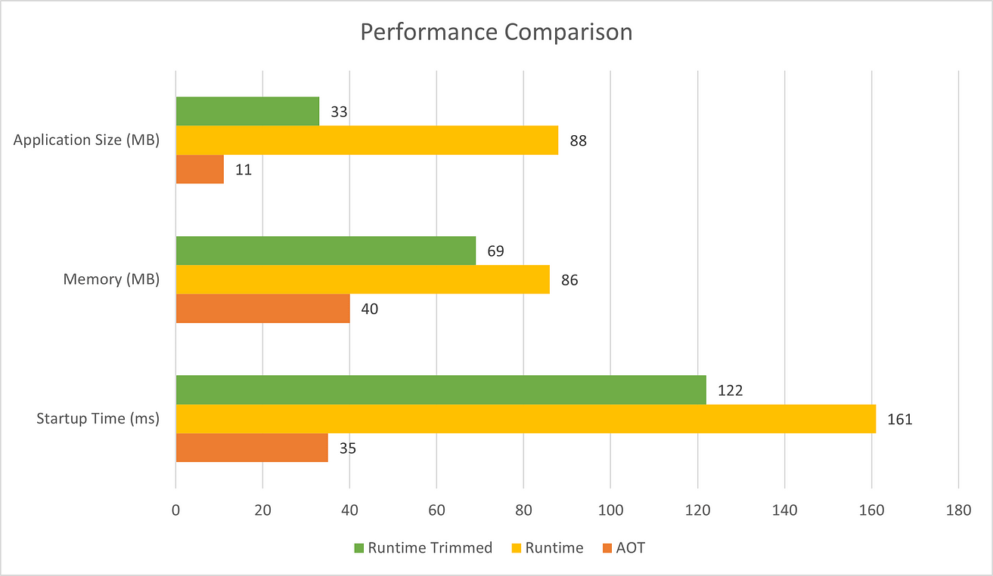
.NET AOT

Slide 32
Environmental impact
Cost savings
Performance

Slide 33


Thanks!
Do you have any questions?
cwoodruff@live.com
woodruff.dev
Twitter @cwoodruff
LinkedIn @chris.woodruff
Please keep this slide for attribution

